Slide 1


ACL 2008: Semi-supervised Learning Tutorial
John Blitzer and Xiaojin Zhu
http://ssl-acl08.wikidot.com

Slide 2
What is semi-supervised learning (SSL)?
Labeled data (entity classification)
Lots more unlabeled data
Labels
…, says Mr. Cooper, vice
president of …
… Firing Line Inc., a
Philadelphia gun shop.
person
location
organization
Can we build a better model from both labeled and unlabeled data?
…, Yahoo’s own Jerry Yang is right …
… The details of Obama’s San Francisco mis-adventure …

Slide 3
Who else has worked on SSL?
Canonical NLP problems
Tagging (Haghighi and Klein 2006)
Chunking, NER (Ando & Zhang 2005)
Parsing (McClosky & Charniak 2006)
Outside the classic NLP canon
Entity-attribute extraction (Bellare et al. 2007)
Sentiment analysis (Goldberg & Zhu 2006)
Link spam detection (Zhou et al. 2007)
Your problem?

Slide 4
Anti-SSL arguments: practice
If a problem is important, we’ll find the time / money / linguists to label more data
IP-HLN
Penn Chinese Treebank
2 years to annotate 4000 sentences
NP-SBJ
VV
结束
NP
NP
DT
NN
NN
NN
全
国
田径
冠军赛
The national track & field championships concluded
I want to parse the baidu zhidao question-answer database.
Who’s going to annotate it for me?

Slide 5
Anti-SSL arguments: theory
“But Tom Cover said”: (Castelli & Cover 1996)
Under a specific generative model, labeled samples are exponentially more useful than unlabeled
The semi-supervised models in this tutorial make different assumptions than C&C (1996)
Today we’ll also discuss new, positive theoretical results in semi-supervised learning

Slide 6
Why semi-supervised learning?
I have a good idea, but I can’t afford to label lots of data!
I have lots of labeled data, but I have even more unlabeled data
SSL: It’s not just for small amounts of labeled data anymore!
Domain adaptation: I have labeled data from 1 domain, but I want a model for a different domain

Slide 7
Goals of this tutorial
Cover the most common classes of semi-supervised learning algorithms
For each major class, give examples of where it has been used for NLP
Give you the ability to know which type of algorithm is right for your problem
Suggest advice for avoiding pitfalls in semi-supervised learning

Slide 8
Overview
Bootstrapping (50 minutes)
Co-training
Latent variables with linguistic side information
Graph-regularization (45 minutes)
Structural learning (55 minutes)
Entity recognition, domain adaptation, and theoretical analysis

Slide 9
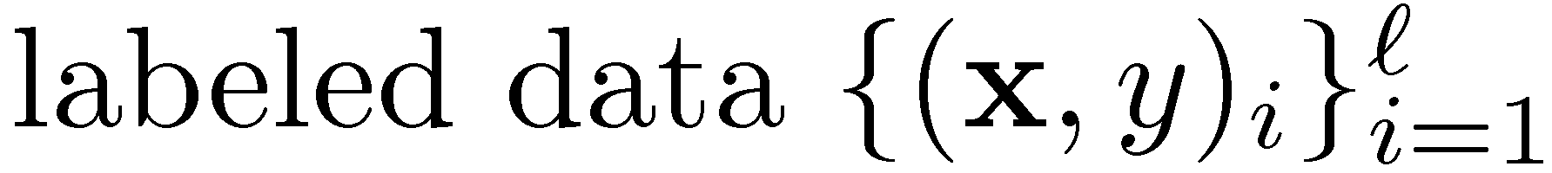
Some notation

Slide 10
Bootstrapping: outline
The general bootstrapping procedure
Co-training and co-boosting
Applications to entity classification and entity-attribute extraction
SSL with latent variables, prototype learning and applications

Slide 11
Bootstrapping
On labeled data, minimize error
On unlabeled data, minimize a proxy for error derived from the current model
Most semi-supervised learning models in NLP
Train model on labeled data
Repeat until converged
Label unlabeled data with current model
Retrain model on unlabeled data

Slide 12
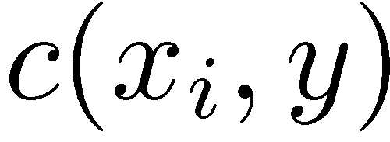
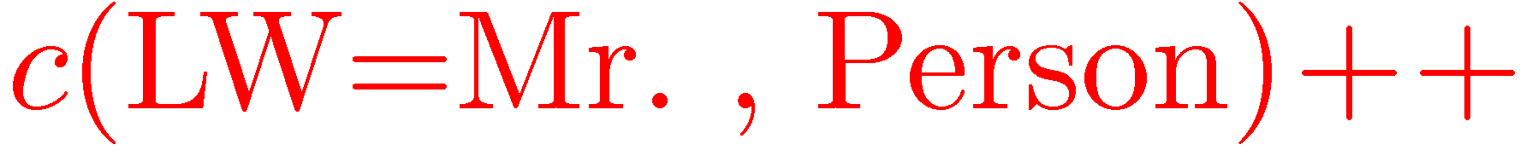
Back to named entities
Naïve Bayes model
Parameters estimated from counts
Features: <left word = “Mr.”>
Label: “Person”
Bootstrapping step
Estimate parameters
Label unlabeled data
Retrain model
Data
Says Mr. Cooper, vice president
Mr. Balmer has already faxed
Mr. Balmer has already faxed
Update action
Label Balmer “Person”

Slide 13

Bootstrapping folk wisdom
Bootstrapping works better for generative models than for discriminative models
Discriminative models can overfit some features
Generative models are forced to assign probability mass to all features with some count
Bootstrapping works better when the naïve Bayes assumption is stronger
“Mr.” is not predictive of “Balmer” if we know the entity is a person

Slide 14
Two views and co-training
Make bootstrapping folk wisdom explicit
There are two views of a problem.
Assume each view is sufficient to do good classification
Named Entity Classification (NEC)
2 views: Context vs. Content
says Mr. Cooper, a vice president of . . .

Slide 15
General co-training procedure
On labeled data, maximize accuracy
On unlabeled data, constrain models from different views to agree with one another
With multiple views, any supervised learning algorithm can be co-trained

Slide 16



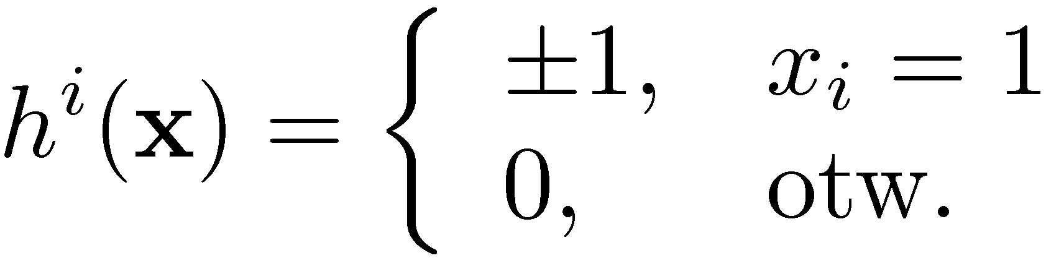
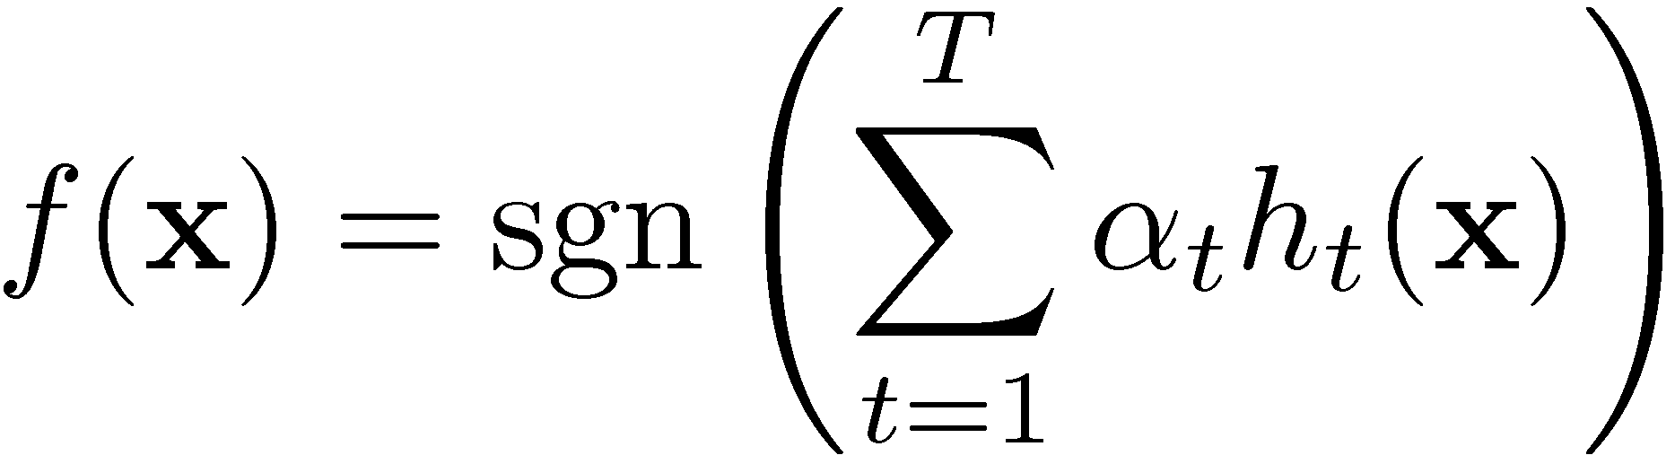
Co-boosting for named entity classification
Collins and Singer (1999)
A brief review of supervised boosting
Boosting runs for t=1…T rounds.
On round t, we choose a base model and weight
For NLP, the model at round t,
identifies the presence of a particular
feature and guesses or abstains
Final model:

Slide 17
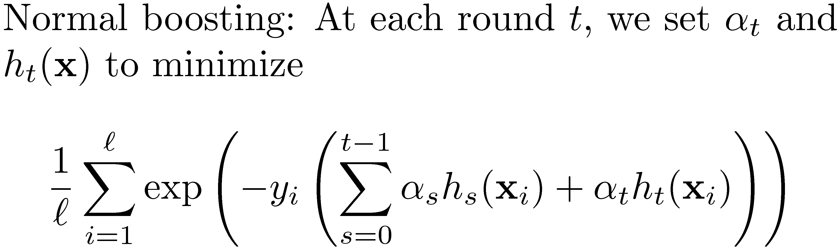
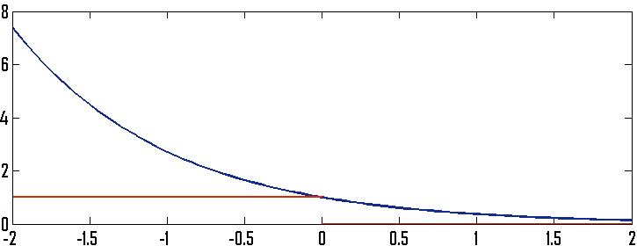
Boosting objective
Current model, steps 1. . .t-1
0-1 loss
loss
exp loss

Slide 18
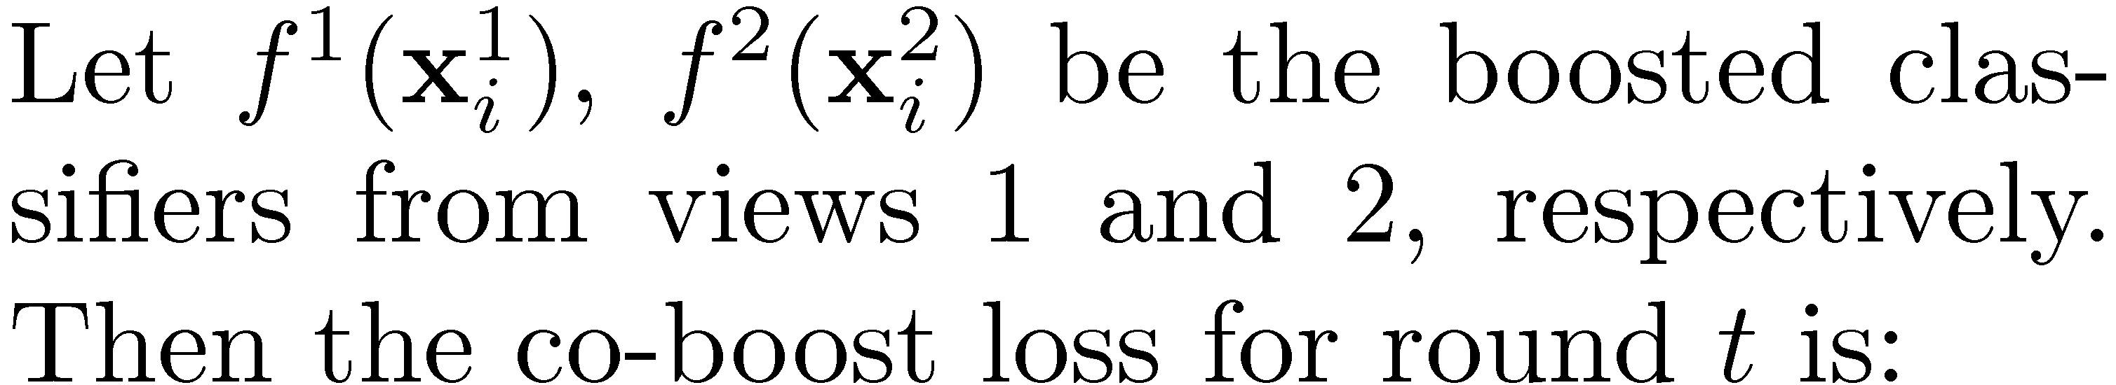

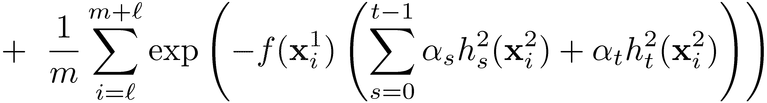
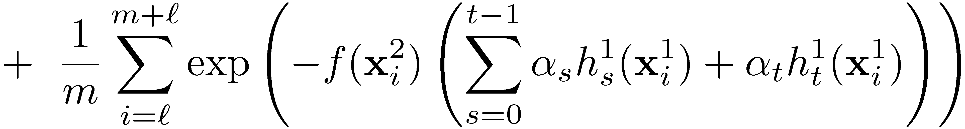
Co-boosting objective
view 2 loss
subscript: round of boosting
superscript: view
view 1 loss

Slide 19
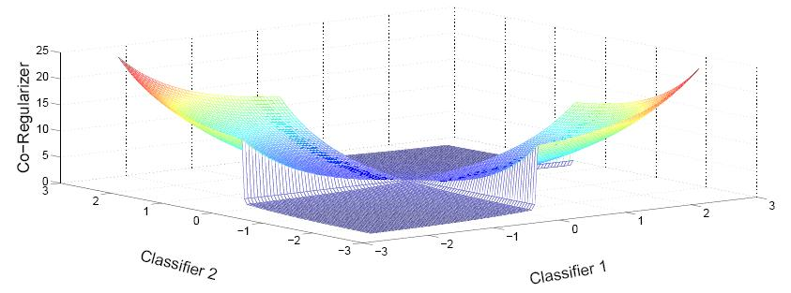
Unlabeled co-regularizer
Scores of individual ensembles ( x- and y-axis ) vs.
Co-regularizer term ( z-axis )
score magnitude important for disagreement
score magnitude not important for agreement

Slide 20
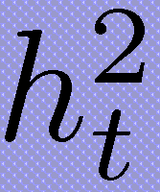
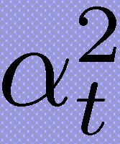
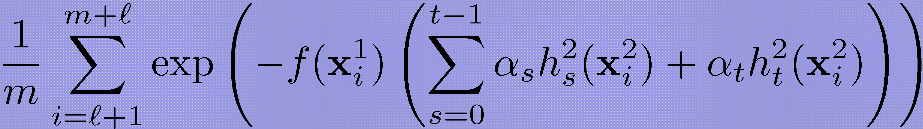
Co-boosting updates
Optimize each view separately.
Set hypothesis , to minimize
Similarly for view 1
Each greedy update is guaranteed to decrease one view of the objective

Slide 21
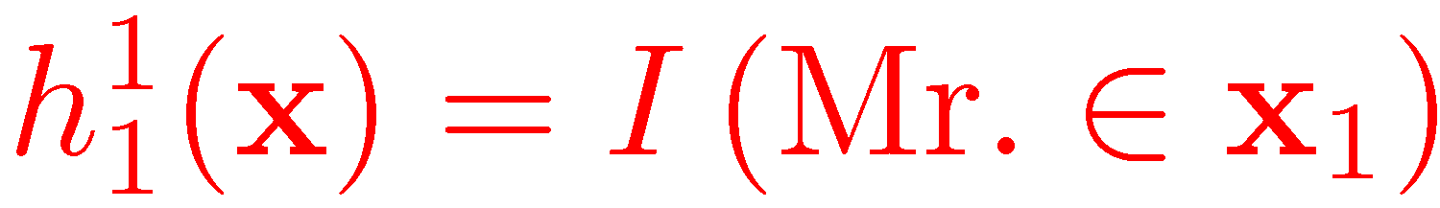
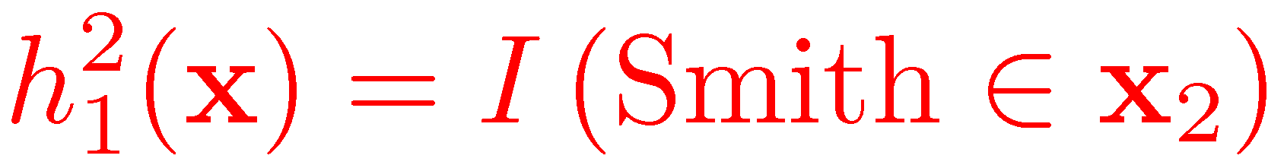
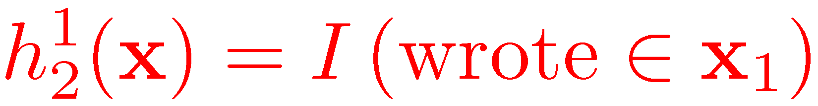
Basic co-boosting walk-through
Labeled: Mr. Balmer has already faxed
Unlabeled: says Mr. Smith, vice president of
Adam Smith wrote “The Wealth of Nations”
Co-boosting step
Update context view
Label unlabeled data
Update content view
Label unlabeled data
Update context view
Data
Mr. Balmer has already faxed
says Mr. Smith, vice president
says Mr. Smith, vice president
Adam Smith wrote “The Wealth of Nations”
Adam Smith wrote . . .
Update action
Label “Person”
Label “Person”

Slide 22
Co-boosting NEC Results
Data: 90,000 unlabeled named entities
Seeds: Location – New York, California, U.S
Person context – Mr.
Organization name – I.B.M., Microsoft
Organization context – Incorporated
Create labeled data using seeds as rules
Whenever I see Mr. ____, label it as a person
Results
Baseline (most frequent) 45% Co-boosting: 91%

Slide 23
Entity-attribute extraction
Bellare et al. (2008)
Entities: companies, countries, people
Attributes: C.E.O., market capitalization, border, prime minister, age, employer, address
Extracting entity-attribute pairs from sentences
The population of China exceeds
L x M y R
L,M,R = context x,y = content

Slide 24
Data and learning
Input: seed list of entities and attributes
2 views: context and content
Training: co-training decision lists and self-trained MaxEnt classifier
Problem: No negative instances
Just treat all unlabeled instances as negative
Re-label most confident positive instances

Slide 25
Examples of learned attributes
Countries and attributes
<Malaysia, problems>, <Nepal, districts>, <Colombia, important highway>
Companies and attributes
<Limited Too, chief executive>, <Intel, speediest chip>, <Uniroyal, former chairman>

Slide 26
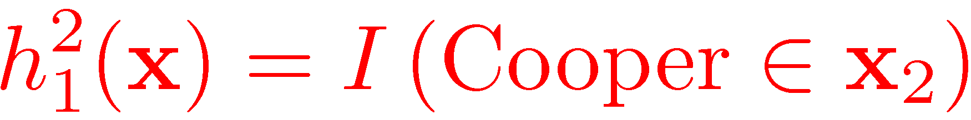
Where can co-boosting go wrong?
Co-boosting enforces agreement on unlabeled data
If only 1 view can classify correctly, this causes errors
Co-boosting step
Update context view
Label unlabeled data
Update content view
Label unlabeled data
Data
Mr. Balmer has already faxed
says Mr. Cooper, vice president
says Mr. Cooper, vice president
Cooper Tires spokesman John
Update action
Label “Person”
Label “Person”

Slide 27
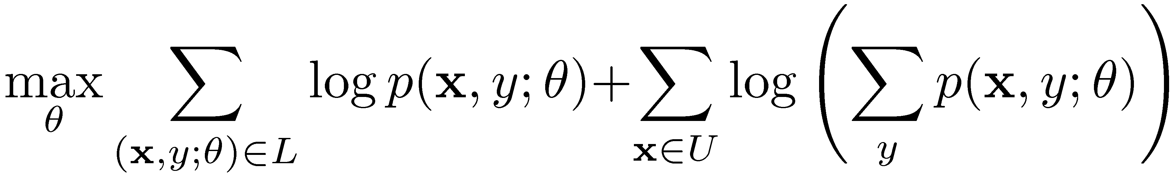
SSL with latent variables
Maximize likelihood treating unlabeled labels as hidden
Labeled data gives us basic label-feature structure. Maximum likelihood (MLE) via EM fills in the gaps
Y=<Person>
Y=<hidden>
RW=<president>
RW=<has>
MW=<Cooper>
MW=<Balmer>
LW=<Mr.>
LW=<Mr.>

Slide 28
Where can MLE go wrong?
Unclear when likelihood and error are related
Collins & Singer (1999) : co-boosting 92%, EM: 83%
Mark Johnson. Why doesn’t EM find good HMM POS-taggers? EMNLP 2007.
How can we fix MLE?
Good solutions are high likelihood, even if they’re not maximum likelihood
Coming up: Constrain solutions to be consistent with linguistic intuition

Slide 29
Prototype-driven learning
Haghighi and Klein 2006
Standard SSL
Prototype learning (part of speech)
labeled data
unlabeled data
prototypes
training data
NN | president percent
VBD | said, was had
JJ | new, last, other
Each instance is partially labeled
Prototypes force representative instances to be consistent

Slide 30
Using prototypes in HMMs
<Y=VBD>
<Y hidden>
<Y=NN>
. . .
says Mr. Cooper, vice president of . . .
MW=president
LW = vice
suffix = dent
EM Algorithm: Constrained forward-backward
Haghighi and Klein (2006) use Markov random fields

Slide 31
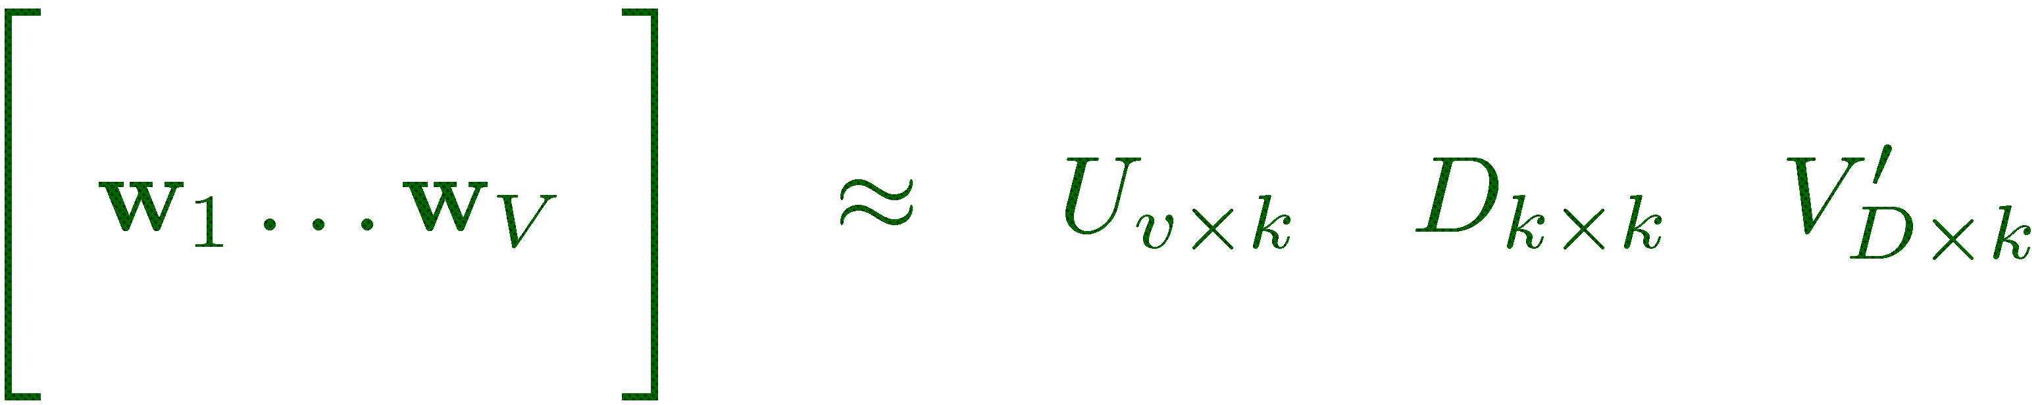
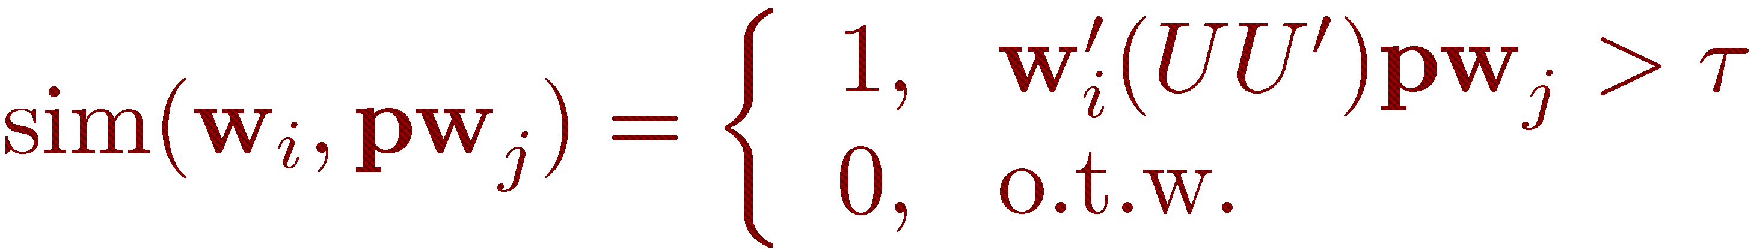
Incorporating distributional similarity
Represent each word by bigram counts with most frequent words on left & right
k-dimensional representation via SVD
president
LW=“vice”: 0.1
LW=“the”: 0.02
. . .
RW=“of”: 0.13
. . .
RW=“said”: 0.05
Similarity between a word and prototype
We’ll see a similar idea when discussing structural learning

Slide 32
Results: Part of speech tagging
Prototype Examples (3 prototypes per tag)
NN | president | IN | of | JJ | new
VBD | said | NNS | shares | DET | the
CC | and | TO | to | CD | million
NNP | Mr. | PUNC | . | VBP | are
Results
BASE | 46.4%
PROTO | 67.7%
PROTO+SIM | 80.5%
Notes:
* In order to learn a POS model, we just change the prototype list

Slide 33
Results: Classified Ads
Goal: Segment housing advertisements
Size
Restrict
Terms
Location
Remodeled 2 Bdrms/1 Bath, spacious upper unit, located in Hilltop Mall area. Walking distance to shopping, public transportation, and schools. Paid water and garbage. No dogs allowed.
Prototype examples
Results
LOCATION | near, shopping
TERMS | paid, utilities
SIZE | large, spacious
RESTRICT | dogs, smoking
BASE | 46.4%
PROTO | 53.7%
PROTO+SIM | 71.5%
Computed from bag-of-words in current sentence
Notes:
* Two sequence examples in this talk, this is one

Slide 34
Comments on bootstrapping
Easy to write down and optimize.
Hard to predict failure cases
Co-training encodes assumptions as 2-view agreement
Prototype learning enforces linguistically consistent constraints on unsupervised solutions
Co-training doesn’t always succeed
Structural learning section
Prototype learning needs good SIM features to perform well

Slide 35
Entropy and bootstrapping
Haffari & Sarkar 2007. Analysis of Semi-supervised Learning with the Yarowsky Algorithm.
Variants of Yarowsky algorithm minimize entropy of
p(y | x) on unlabeled data.
Other empirical work has looked at minimizing entropy directly.
Entropy is not error.
Little recent theoretical work connecting entropy & error

Slide 36
More bootstrapping work
McClosky & Charniak (2006). Effective Self-training for Parsing. Self-trained Charniak parser on WSJ & NANC.
Aria Haghighi’s prototype sequence toolkit. http://code.google.com/p/prototype-sequence-toolkit/
Mann & McCallum (2007). Expectation Regularization. Similar to prototype learning, but develops a regularization framework for conditional random fields.

Slide 37
Graph-based Semi-supervised Learning
From items to graphs
Basic graph-based algorithms
Mincut
Label propagation and harmonic function
Manifold regularization
Advanced graphs
Dissimilarities
Directed graphs
TexPoint fonts used in EMF.
Read the TexPoint manual before you delete this box.: AAAAAAAAAAA

Slide 38
Text classification: easy example
Two classes: astronomy vs. travel
Document = 0-1 bag-of-word vector
Cosine similarity
x1=“bright asteroid”, y1=astronomy
x2=“yellowstone denali”, y2=travel
x3=“asteroid comet”?
x4=“camp yellowstone”?
Easy, by word overlap

Slide 39
Hard example
x1=“bright asteroid”, y1=astronomy
x2=“yellowstone denali”, y2=travel
x3=“zodiac”?
x4=“airport bike”?
No word overlap
Zero cosine similarity
Pretend you don’t know English

Slide 40
Hard example
 | x1 | x3 | x4 | x2
asteroid | 1
bright | 1
comet
zodiac |  | 1
airport |  |  | 1
bike |  |  | 1
yellowstone |  |  |  | 1
denali |  |  |  | 1

Slide 41
Unlabeled data comes to the rescue
 | x1 | x5 | x6 | x7 | x3 | x4 | x8 | x9 | x2
asteroid | 1
bright | 1 | 1 | 1
comet |  | 1 | 1 | 1
zodiac |  |  |  | 1 | 1
airport |  |  |  |  |  | 1
bike |  |  |  |  |  | 1 | 1 | 1
yellowstone |  |  |  |  |  |  | 1 | 1 | 1
denali |  |  |  |  |  |  |  | 1 | 1

Slide 42
Intuition
Some unlabeled documents are similar to the labeled documents ➔ same label
Some other unlabeled documents are similar to the above unlabeled documents ➔ same label
ad infinitum
We will formalize this with graphs.

Slide 43
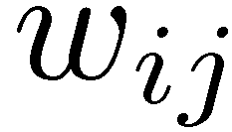
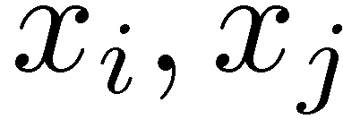
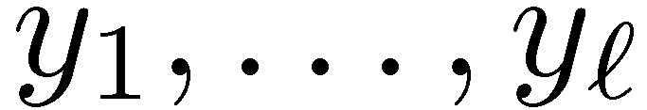
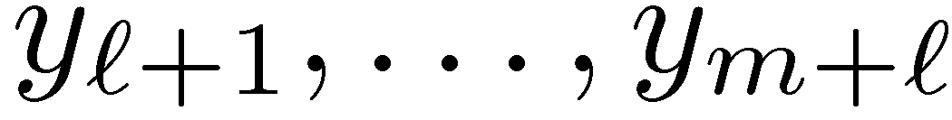
The graph
Nodes
Weighted, undirected edges
Large weight ➔ similar
Known labels
Want to know
transduction:
induction:

Slide 44
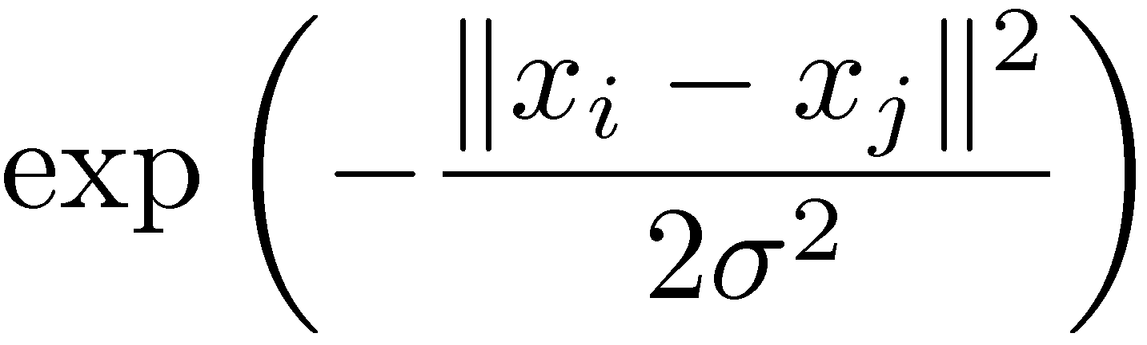
How to create a graph
Empirically, the following works well:
Compute distance between i, j
For each i, connect to its kNN. k very small but still connects the graph
Optionally put weights on (only) those edges
4. Tune σ

Slide 45
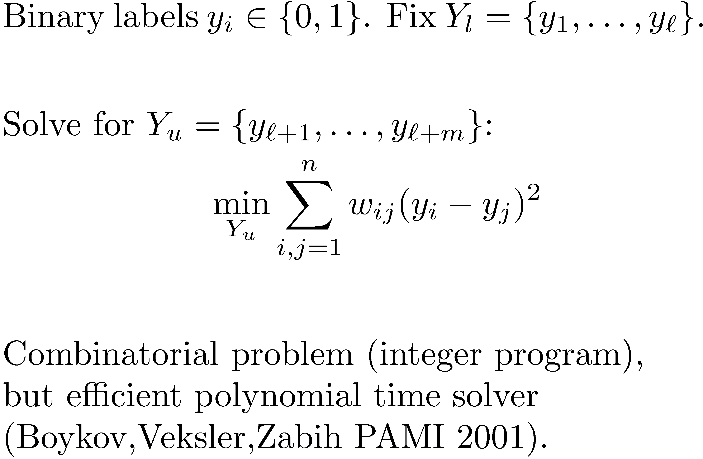
Mincut (st-cut)

Slide 46
Mincut example: subjectivity
Task: classify each sentence in a document into objective/subjective. (Pang,Lee. ACL 2004)
NB/SVM for isolated classification
Subjective data (y=1): Movie review snippets “bold, imaginative, and impossible to resist”
Objective data (y=0): IMDB
But there is more…

Slide 47
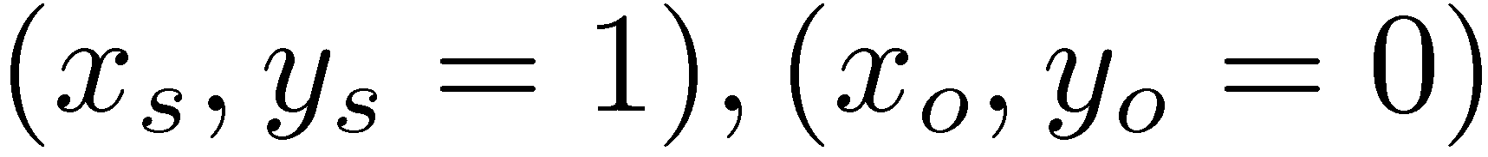
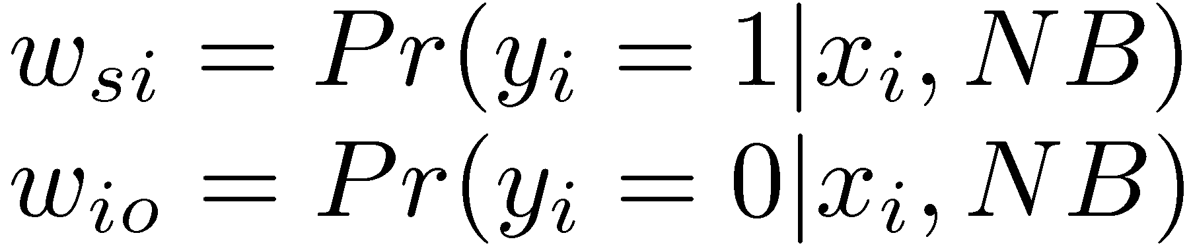
Mincut example: subjectivity
Key observation: sentences next to each other tend to have the same label
Two special labeled nodes (source, sink)
Every sentence connects to both:

Slide 48
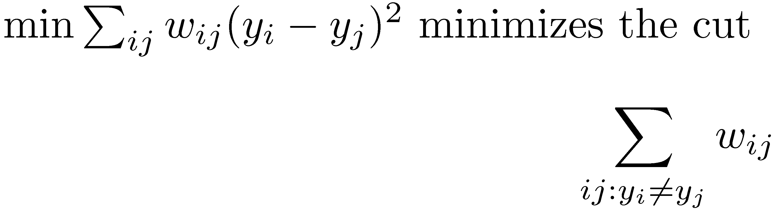
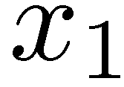
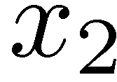
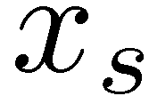
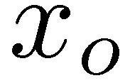
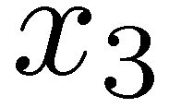
Mincut example: subjectivity

Slide 49
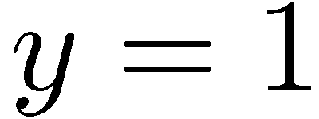
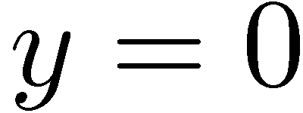
Some issues with mincut
Multiple equally min cuts, but different
Lacks classification confidence
These are addressed by harmonic functions and label propagation

Slide 50
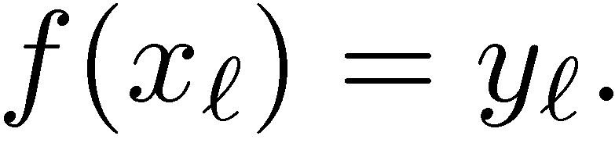
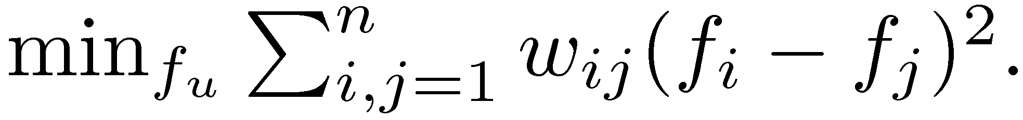
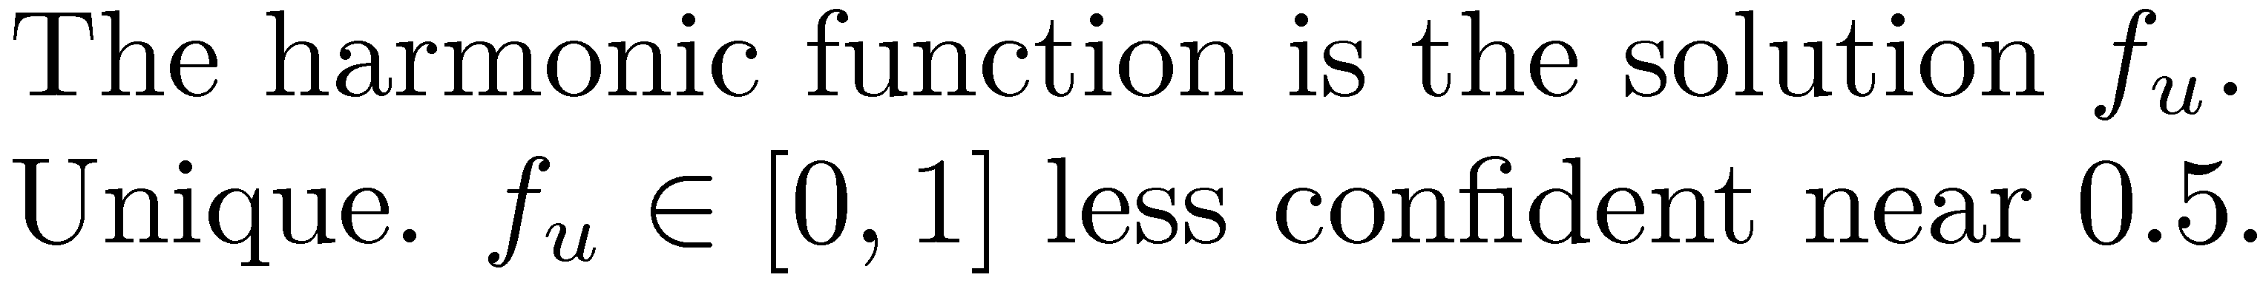
Harmonic Function

Slide 51
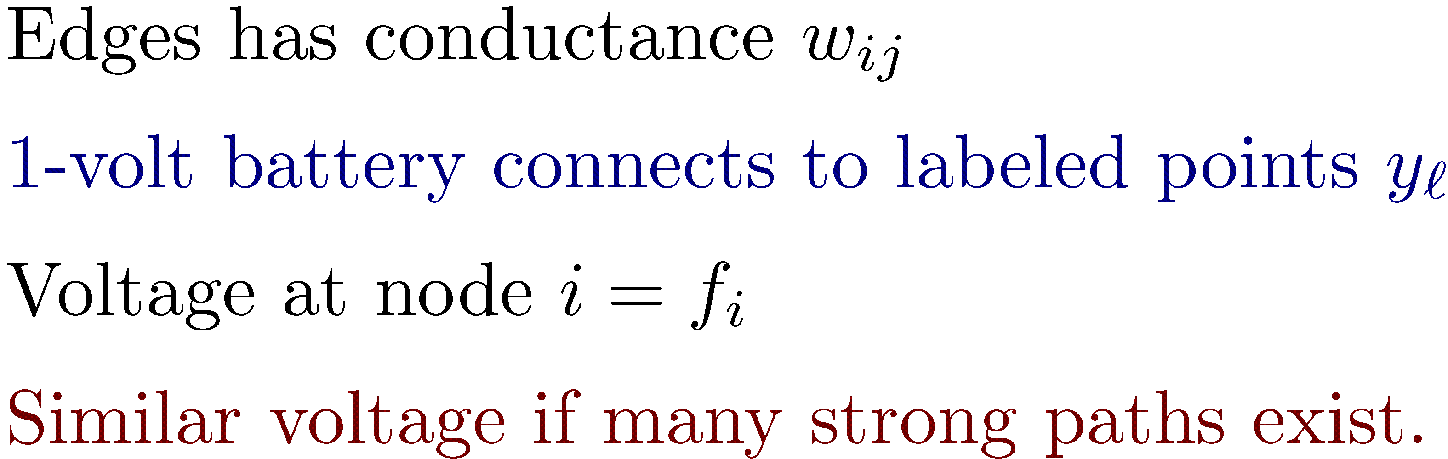
An electric network interpretation

Slide 52
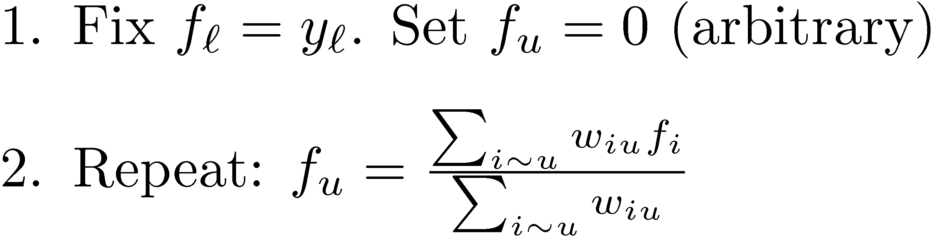
Label propagation

Slide 53
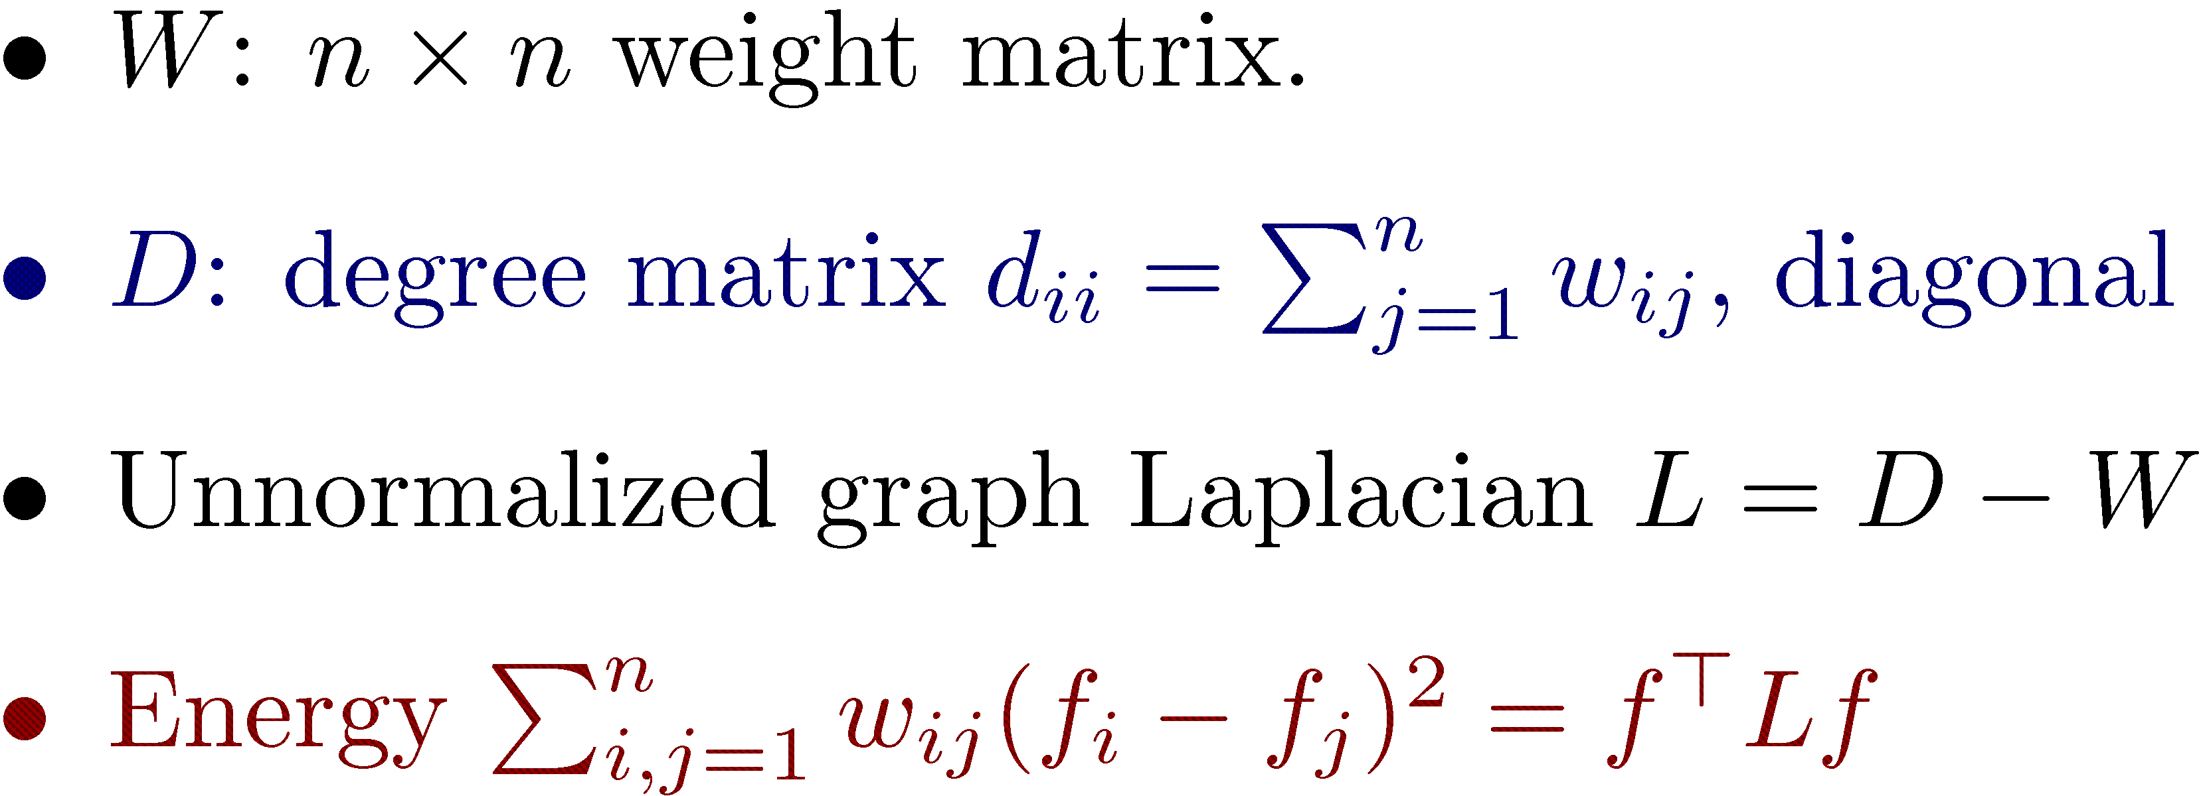
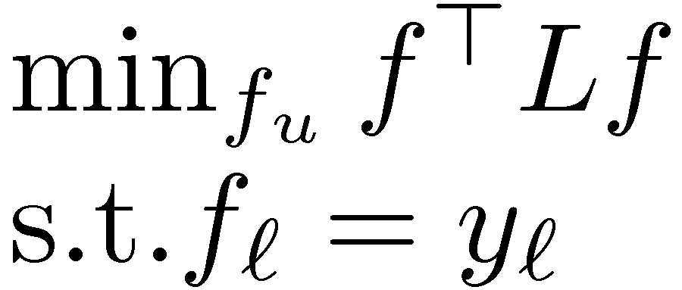
The graph Laplacian

Slide 54
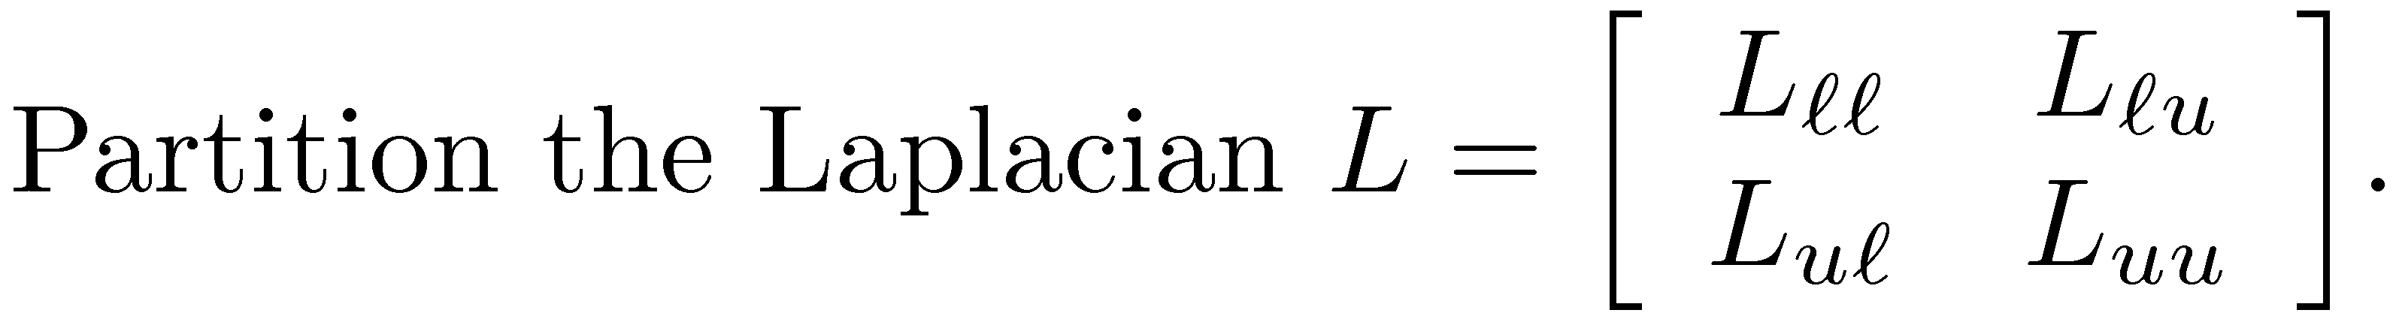
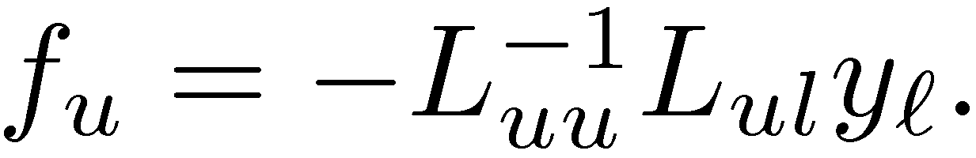
Closed-form solution

Slide 55
Harmonic example 1: WSD
WSD from context, e.g., “interest”, “line” (Niu,Ji,Tan ACL 2005)
x_{i}: context of the ambiguous word, features: POS, words, collocations
d_{ij}: cosine similarity or JS-divergence
w_{ij}: kNN graph
Labeled data: a few x_{i}’s are tagged with their word sense.

Slide 56
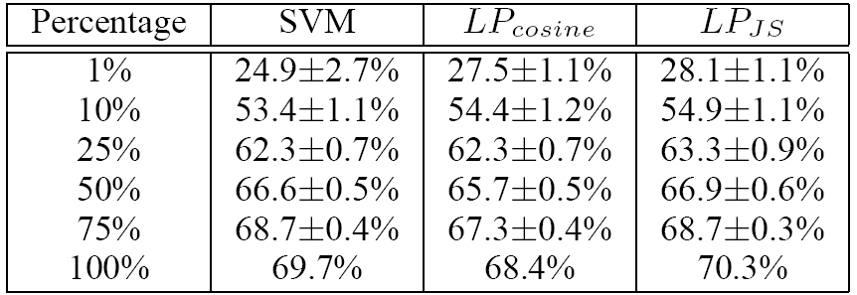
Harmonic example 1: WSD
SENSEVAL-3, as percent labeled:
(Niu,Ji,Tan ACL 2005)

Slide 57
Harmonic example 2: sentiment
Rating (0-3) from movie reviews (Goldberg,Zhu. NAACL06 workshop)
x_{i}: movie reviews
w_{ij}: cosine similarity btw “positive sentence percentage” (PSP) vectors of x_{i,} x_{j}
PSP classifier trained on “snippet” data (Pang,Lee. ACL 2005)

Slide 58
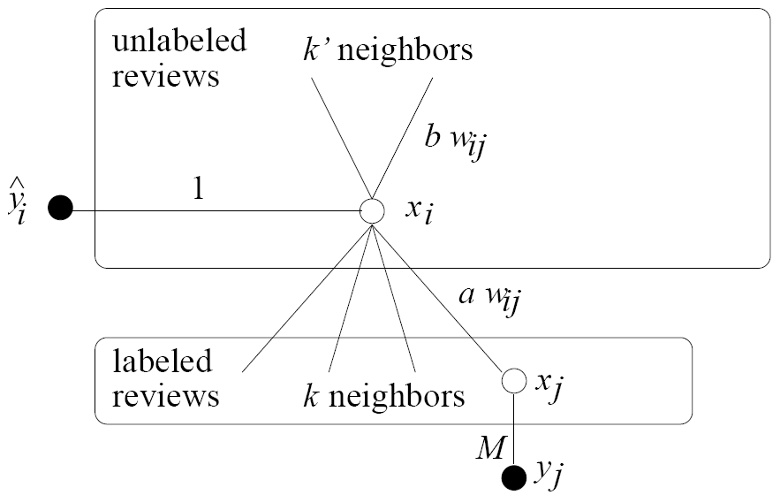
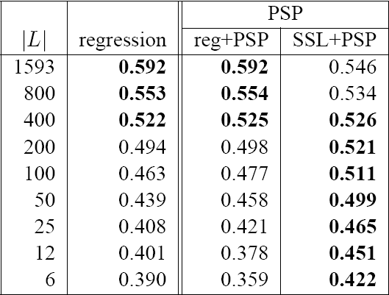
Harmonic example 2: sentiment
Graph Accuracy

Slide 59
Some issues with harmonic function
It fixes the given labels y_{l}
What if some labels are wrong?
It cannot easily handle new test items
Transductive, not inductive
Add test items to graph, recompute
Manifold regularization addresses these issues

Slide 60

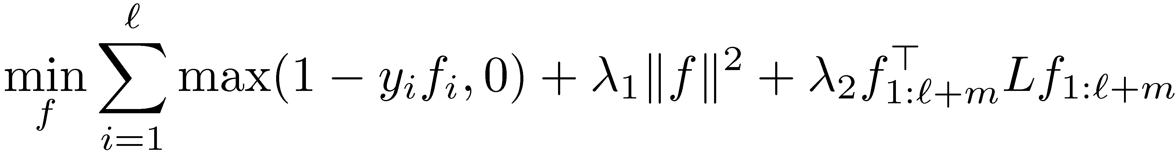

Manifold regularization

Slide 61


Manifold example
Text classification (Sindhwani,Niyogi,Belkin.ICML 2005)
x_{i}: mac/windows. TFIDF.
w_{ij}: weighted kNN graph

Slide 62


Advanced topics
So far edges denote symmetric similarity
Larger weights ➔ similar labels
What if we have dissimilarity knowledge?
“Two items probably have different labels”
What if the relation is asymmetric?
related to but not always related to

Slide 63
Dissimilarity
Political view classification
(Goldberg, Zhu, Wright. AISTATS 2007)
They disagree ➔ different classes
Indicators: quoting, !?, all caps (internet shouting), etc.
> deshrubinator: “You were the one who thought it should be investigated last week.”
Dixie: No I didn’t, and I made it clear. You are insane! YOU are the one with NO ****ING RESPECT FOR DEMOCRACY!

Slide 64


Dissimilarity
Recall to encode similarity between i,j:
Wrong ways: small w = no preference; negative w nasty optimization
One solution (also see (Tong,Jin.AAAI07))
Overall
depends on dissim, sim

Slide 65

Directed graphs
Spam vs. good webpage classification (Zhou,Burges,Tao. AIRW 2007)
Hyperlinks as graph edges, a few webpages manually labeled

Slide 66
Directed graphs
Directed hyperlink edges
Can define an analogous “directed graph Laplacian” + manifold regularization
X
spam
X more likely spam
X
spam
X may be good

Slide 67
Caution
Advantages of graph-based methods:
Clear intuition, elegant math
Performs well if the graph fits the task
Disadvantages:
Performs poorly if the graph is bad: sensitive to graph structure and edge weights
Usually we do not know which will happen!

Slide 68
Structural learning: outline
The structural learning algorithm
Application to named entity recognition
Domain adaptation with structural correspondence learning
Relationship between structural and two-view learning

Slide 69
Structural learning
Ando and Zhang (2005). Use unlabeled data to constrain structure of hypothesis space
Given a target problem (entity classification)
Design auxiliary problems
Look like target problem
Can be trained using unlabeled data
Regularize target problem hypothesis to be close to auxiliary problem hypothesis space

Slide 70
What are auxiliary problems?
2 criteria for auxiliary problems
Look like target problem
Can be trained from unlabeled data
Named entity classification: Predict presence or absence of left / middle / right words
Left
Mr.
President
Middle
Thursday
John
York
Right
Corp.
Inc.
said

Slide 71

Auxiliary problems for sentiment classification
Running with Scissors: A Memoir
Title: Horrible book, horrible.
This book was horrible. I read half of it, suffering from a headache the entire time, and eventually i lit it on fire. One less copy in the world...don't waste your money. I wish i had the time spent reading this book back so i could use it for better purposes. This book wasted my life
Labels
Running with Scissors: A Memoir
Title: Horrible book, horrible.
This book was horrible. I read half of it, suffering from a headache the entire time, and eventually i lit it on fire. One less copy in the world...don't waste your money. I wish i had the time spent reading this book back so i could use it for better purposes. This book wasted my life
Positive
Negative
Auxiliary Problems
Presence or absence of frequent words and bigrams
don’t_waste, horrible, suffering

Slide 72




Auxiliary problem hypothesis space
Consider linear, binary auxiliary predictors:
weight vector for auxiliary problem i
Given a new hypothesis weight vector , how far is it from ?

Slide 73






Two steps of structural learning
Step 1: Use unlabeled data and auxiliary problems to learn a representation : an approximation to
low-dimensional representation
1
0
0.3
.
.
.
-1.0
.
.
.
Features:
<left word = “Mr.”>
0
0.7
-2.1
weights learned from labeled data
1
Step 2: Use labeled data to learn weights for the new representation

Slide 74
Unlabeled step: train auxiliary predictors
For each unlabeled instance, create a binary presence / absence label
(1) The book is so repetitive that I found myself yelling …. I will definitely not buy another.
(2) An excellent book. Once again, another wonderful novel from Grisham
Binary problem: Does “not buy” appear here?
Mask and predict pivot features using other features
Train n linear predictors, one for each binary problem
Auxiliary weight vectors give us clues about feature conditional covariance structure

Slide 75


Unlabeled step: dimensionality reduction
gives n new features
value of i^{th} feature is the propensity to see “not buy” in the same document
We want a low-dimensional representation
Many pivot predictors give similar information
“horrible”, “terrible”, “awful”
Compute SVD & use top left singular vectors
Notes:
********* We model an explicitly constructed feature-feature matrix by choosing pivots *********
********* We estimate the entries of that matrix discriminatively *********

Slide 76

Step 2: Labeled training
Step 2: Use to regularize labeled objective
low-dimensional weight vector for learned features
Original, high-dimensional weight vector
Only high-dimensional features have quadratic regularization term

Slide 77

Step 2: Labeled training
Comparison to prototype similarity
Uses predictor (weight vector) space, rather than counts
Similarity is learned rather than fixed

Slide 78

Results: Named entity recognition
Data: CoNLL 2003 shared task
Labeled: 204 thousand tokens of Reuters news data
Annotations: person, location, organization, miscellaneous
Unlabeled: 30 million words of Reuters news data
A glance of some of the rows of
ROW # | Features
4 | Ltd, Inc, Plc, International, Association, Group
9 | PCT, N/A, Nil, Dec, BLN, Avg, Year-on-Year
11 | San, New, France, European, Japan
15 | Peter, Sir, Charles, Jose, Paul, Lee

Slide 79
Numerical Results (F-measure)
Data size | 10k tokens | 204k tokens
Model
Baseline | 72.8 | 85.4
Co-training | 73.1 | 85.4
Structural | 81.3 | 89.3
Large difference between co-training here and co-boosting (Collins & Singer 1999)
This task is entity recognition, not classification
We must improve over a supervised baseline

Slide 80
Domain adaptation with structural learning
Blitzer et al. (2006): Structural Correspondence Learning (SCL)
Blitzer et al. (2007): For sentiment: books & kitchen appliances
Running with Scissors: A Memoir
Title: Horrible book, horrible.
This book was horrible. I read half of it, suffering from a headache the entire time, and eventually i lit it on fire. One less copy in the world...don't waste your money. I wish i had the time spent reading this book back so i could use it for better purposes. This book wasted my life
Running with Scissors: A Memoir
Title: Horrible book, horrible.
This book was horrible. I read half of it, suffering from a headache the entire time, and eventually i lit it on fire. One less copy in the world...don't waste your money. I wish i had the time spent reading this book back so i could use it for better purposes. This book wasted my life
Avante Deep Fryer, Chrome & Black
Title: lid does not work well...
I love the way the Tefal deep fryer cooks, however, I am returning my second one due to a defective lid closure. The lid may close initially, but after a few uses it no longer stays closed. I will not be purchasing this one again.
Avante Deep Fryer, Chrome & Black
Title: lid does not work well...
I love the way the Tefal deep fryer cooks, however, I am returning my second one due to a defective lid closure. The lid may close initially, but after a few uses it no longer stays closed. I will not be purchasing this one again.
Error increase: 13% → 26%

Slide 81
Pivot Features
Pivot features are features which are shared across domains
Unlabeled kitchen contexts
Unlabeled books contexts
Do not buy the Shark portable steamer …. Trigger mechanism is defective.
the very nice lady assured me that I must have a defective set …. What a disappointment!
Maybe mine was defective …. The directions were unclear
The book is so repetitive that I found myself yelling …. I will definitely not buy another.
A disappointment …. Ender was talked about for <#> pages altogether.
it’s unclear …. It’s repetitive and boring
Use presence of pivot features as auxiliary problems

Slide 82



Choosing pivot features: mutual information
Pivot selection (SCL): Select top features by shared counts
Pivot selection (SCL-MI): Select top features in two passes
(1) Filter feature if min count in both domains < k
(2) Select top filtered features by
Books-kitchen example
In SCL, not SCL-MI
In SCL-MI, not SCL
book one <num> so all very about they like good when | a_must a_wonderful loved_it weak don’t_waste awful highly_recommended and_easy

Slide 83
Sentiment Classification Data
Product reviews from Amazon.com
Books, DVDs, Kitchen Appliances, Electronics
2000 labeled reviews from each domain
3000 – 6000 unlabeled reviews
Binary classification problem
Positive if 4 stars or more, negative if 2 or less
Features: unigrams & bigrams
Pivots: SCL & SCL-MI
At train time: minimize Huberized hinge loss (Zhang, 2004)

Slide 84

Visualizing (books & kitchen)
negative vs. positive
books
engaging
must_read
plot
<#>_pages
predictable
fascinating
grisham
poorly_designed
awkward_to
espresso
years_now
the_plastic
leaking
are_perfect
a_breeze
kitchen

Slide 85
Empirical Results: books & DVDs
on average, scl-mi reduces error due to adaptation by 36%
baseline loss due to adaptation: 7.6%
SCL-MI loss due to adaptation: 0.7%

Slide 86
Structural learning: Why does it work?
Good auxiliary problems = good representation
Structural learning vs. co-training
Structural learning separates unsupervised and supervised learning
Leads to a more stable solution
Structural learning vs. graph regularization
Use structural learning when auxiliary problems are obvious, but graph is not

Slide 87
Understanding structural learning: goals
Develop a relationship between structural learning and multi-view learning
Discuss assumptions under which structural learning can perform well
Give a bound on the error of structural learning under these assumptions

Slide 88




Structural and Multi-view learning
Context pivots
Orthography features
Context features
Orthography pivots
RW=expounded
LW=Senator
RW=LLC
LW=the
LW=Mr.
RW=said
RW=corp.
Balmer
Smith
Yahoo
General Electric
Brown
Microsoft
Smith

Slide 89




Canonical correlation analysis
Canonical correlation analysis – CCA (Hotelling, 1936)
Correlated features from different views are mapped to similar areas of space
Smith
Mr.
said
Microsoft

Slide 90


Structural learning and CCA
Some changes to structural learning
Minimize squared loss for auxiliary predictors
(2) Block SVD by view: Train auxiliary predictors for view 1 using features from view 2 and vice versa

Slide 91

CCA and semi-supervised learning
Kakade and Foster (2007). Multi-view regression via canonical correlation analysis.
Contrast with co-training: K&F don’t assume independence
Assume:

Slide 92


Semi-supervised learning procedure
Regularize based on amount of correlation
Training error using transformed inputs

Slide 93

A bound on squared error under CCA
Main theorem of Kakade & Foster (2007)
Expected error of learned, transformed predictor
Expected error of best model
Assumption: How good is single view compared to joint model?
number of training examples
amount of correlation

Slide 94
When can structural learning break?
Hard-to-define auxiliary problems
Dependency parsing: How to define auxiliary problems for an edge?
MT alignment: How to define auxiliary problems for a pair of words?
Combining real-valued & binary features
scaling, optimization
high-dimensional, sparse
low-dimensional, dense

Slide 95
Other work on structural learning
Scott Miller et al. (2004). Name Tagging with Word Clusters and Discriminative Training.
Hierarchical clustering, not structural learning.
Representation easily combines with binary features
Rie Ando, Mark Dredze, and Tong Zhang (2005). TREC 2005 Genomics Track Experiments at IBM Watson.
Applying structural learning to information retrieval
Ariadna Quattoni, Michael Collins, and Trevor Darrel (CVPR 2007). Learning Visual Representations using Images with Captions.

Slide 96
SSL Summary
Bootstrapping
Easy to write down. Hard to analyze.
Graph-based Regularization
Works best when graph encodes information not easily represented in normal feature vectors
Structural Learning
With good auxiliary problems, can improve even with lots of training data
Difficult to combine with standard feature vectors

Slide 97
Two take-away messages
Semi-supervised learning yields good results for small amounts of labeled data
“I have lots of labeled data” is not an excuse not to use semi-supervised techniques

Slide 98
http://ssl-acl08.wikidot.com

Slide 99
Semi-supervised learning at ACL 2008
Koo et al. Simple Semi-supervised Dependency Parsing.
Mann & McCallum. Generalized Expectation Criteria for Semi-supervised Learning of Conditional Random Fields.
Pasca & Van Durme. Weakly-supervised Acquisition of Open-Domain Classes and Class Attributes from Web Documents and Query Logs.
Wang et al. Semi-supervised Convex Training for Dependency Parsing.
Suzuki & Isozaki. Semi-supervised Sequential Labeling and Segmentation using Giga-word Scale Unlabeled Data.

